Slide 1

The 17th of January, Thursday.
5 c. My pet.

Slide 2
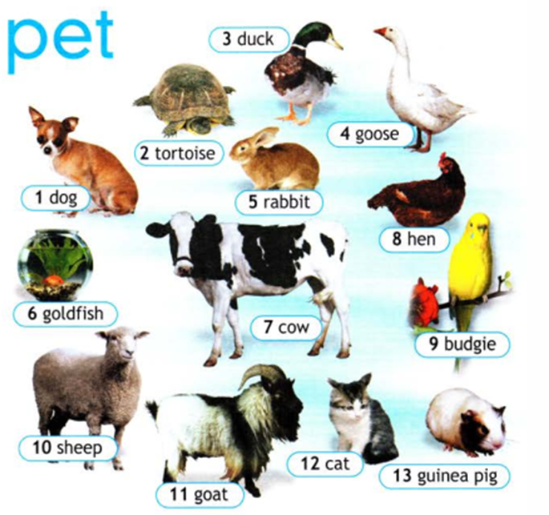


Slide 3
Pets
Farm animals
Dog
Tortoise
Cat
Budgie
Guinea pig
Goldfish
Duck
Goose
Hen
Cow
Rabbit
Goat
sheep

Slide 4
Find new friends and talk about your pets online.

Slide 5
Find new friends and talk about your pets online.
What pet has each person got?
Jessie
Chris has got a …
Sarah

Slide 6
Find new friends and talk about your pets online.
What are their pet’s names?
The cat’s
The budgie’s name is …
The dog’s

